Slide 1
VOCABULARY LEARNING IN A RUSSIAN CLASSROOM
Free copy of ‘Quad-vocab’ ☺
An introduction to ‘Quad Vocab’
Using Quizlet (live)
Small group discussion: “How do pupils best learn vocabulary”

Slide 2
Who am I?
Jon Drury, Head of Russian at Sevenoaks School, Kent
We have about 100 pupils studying Russian from Y8-U6.
We do GCSE and IB (International Baccalaureate)

Slide 3
What is ‘Quad Vocab’?
A Russian vocab book where lists are divided into 4-levels of difficulty
Stress has been added to all words
Grammatical groupings
Frequency list of most common GCSE words (from 2010-2014)
Grammar reference section

Slide 4
Why did you write ‘Quad Vocab’?
To help pupils of different abilities know where to start with vocab learning
To help pupils pronounce words better
To stop me constantly writing out lists on the board (e.g. irreg. short comparatives)
To have all the words in an excel spreadsheet, so I can make vocab tests and Quizlet lists in minutes

Slide 5
Why are you giving it away for free?
I want it to be used!
Our school has been happy to pay for these ‘perfect-bound’ copies for you
Not for profit: Donations encouraged, which will go to support Russia-related charities
If you want to make photocopies for pupils, we encourage you to make a donation for a site licence, allowing unlimited photocopying
You can also order (wiro-bound) copies for your pupils. We’ll do a print run at the end of March.

Slide 6
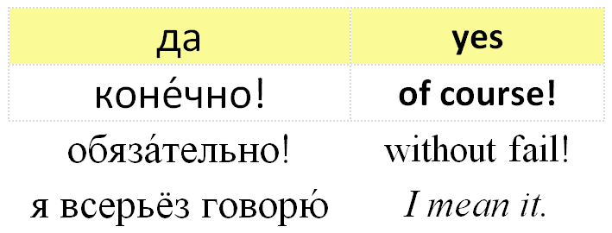
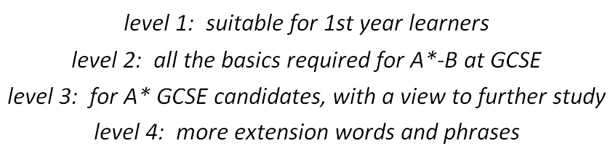
Quad-Vocab – a quick tour!

Slide 7
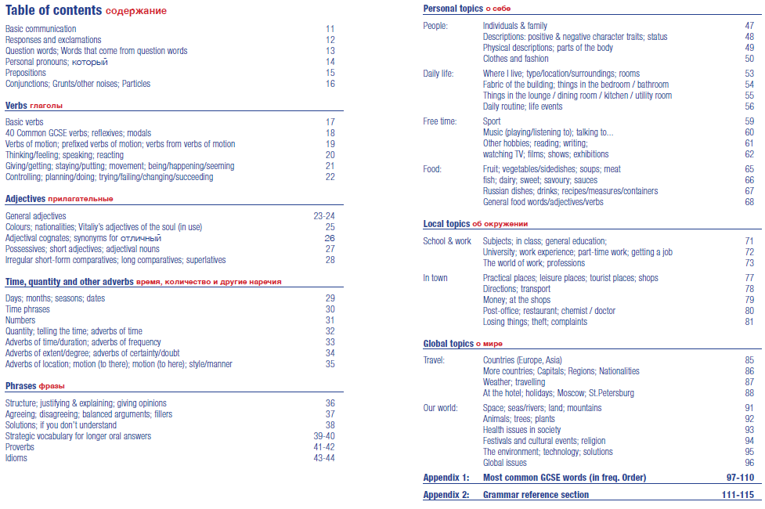
P8-9: Contents Pages

Slide 8
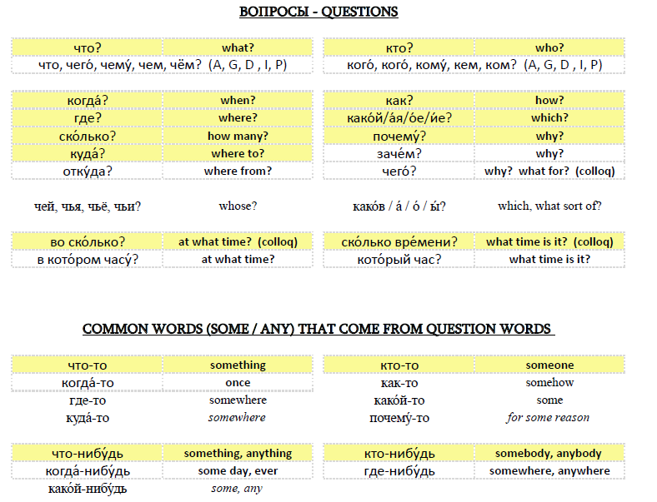
P12: Question words

Slide 9
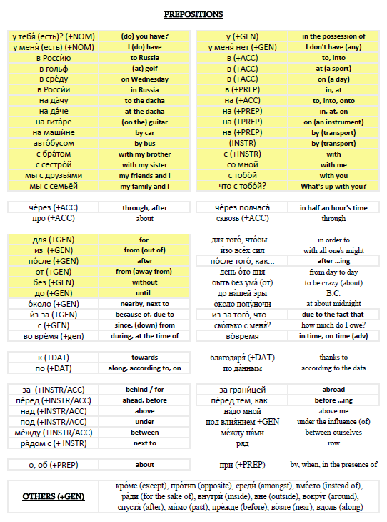
P14: Prepositions
Prepositions are ‘demanding’ – they ‘demand’ a certain case ☺

Slide 10
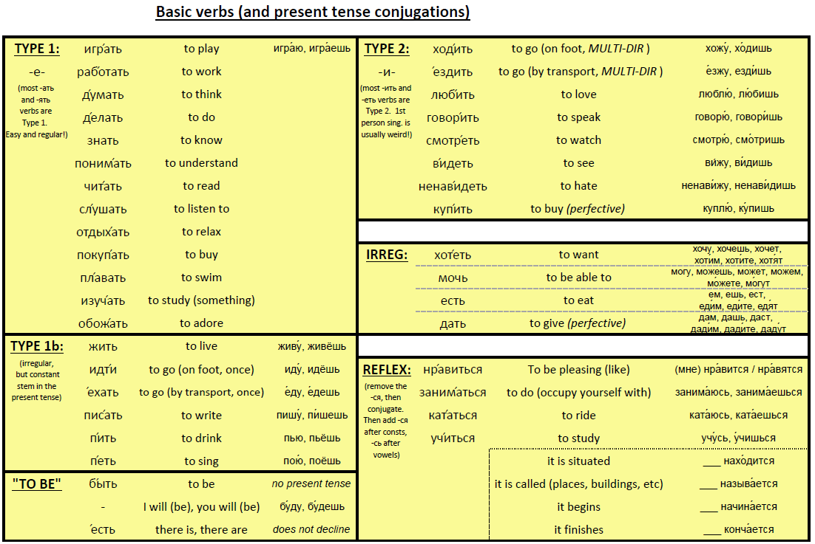
P16: Basic Verbs (+conjugations)

Slide 11
P17 – 19: verbs continued
Introducing perfective pairs
Reflexive verbs
Auxiliary words +INF
Verbs of Motion (+prefixes, etc)

Slide 12
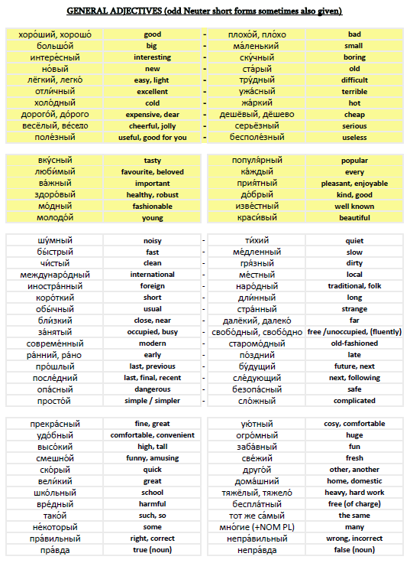
P22-23: Adjectives
In antonym pairs where possible
Selected adverb/ nt. short forms given too
Personal adjs (character & appearance) come later…

Slide 13
P24-27: adjs continued
Colours
Languages
‘Vitaliy’s adjectives of the soul (in use)’
Adjectival cognates
Synonyms for ‘very good’
Adjectival nouns

Slide 14
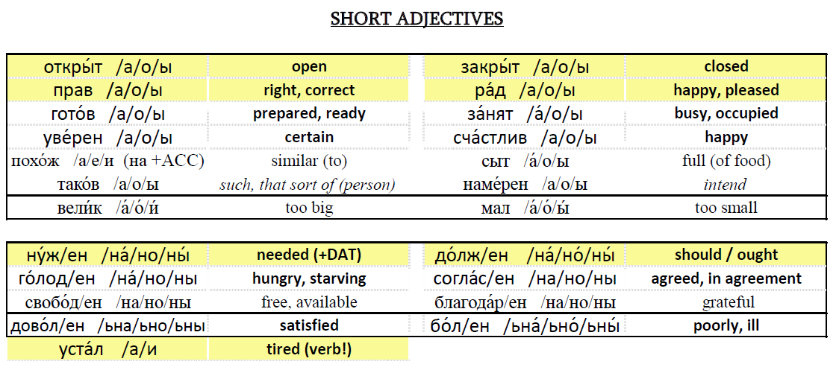
P26: short adjectives
Sections according to whether fleeting vowels or soft-signs appear in conjugation

Slide 15
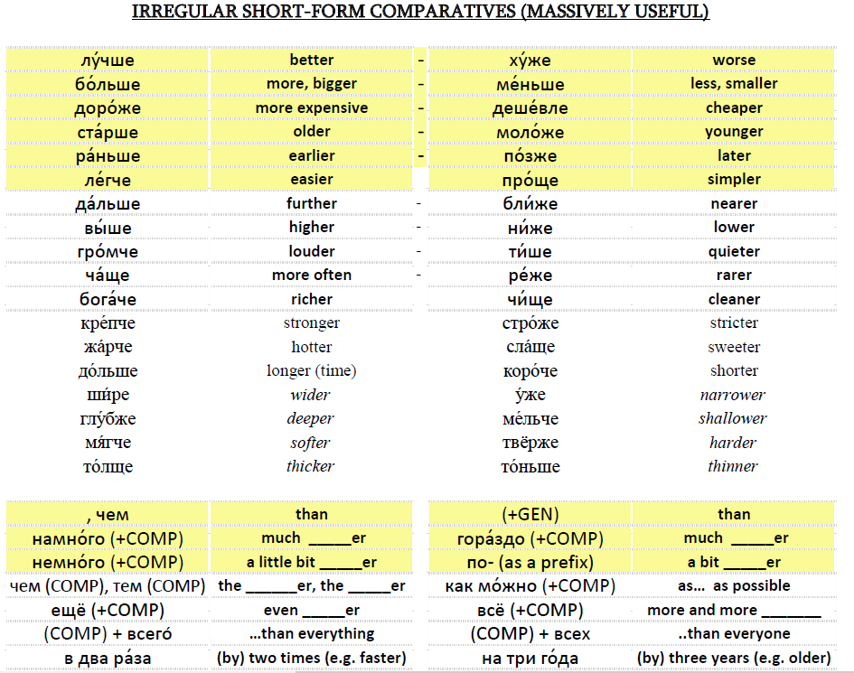
P27: irreg. short form comparatives

Slide 16
P28-34: Adverbs (everything else!)
Time phrases (days, months, seasons)
Numbers
Quantity
Time
Adverbs: when, frequency, duration, extent / degree, location

Slide 17
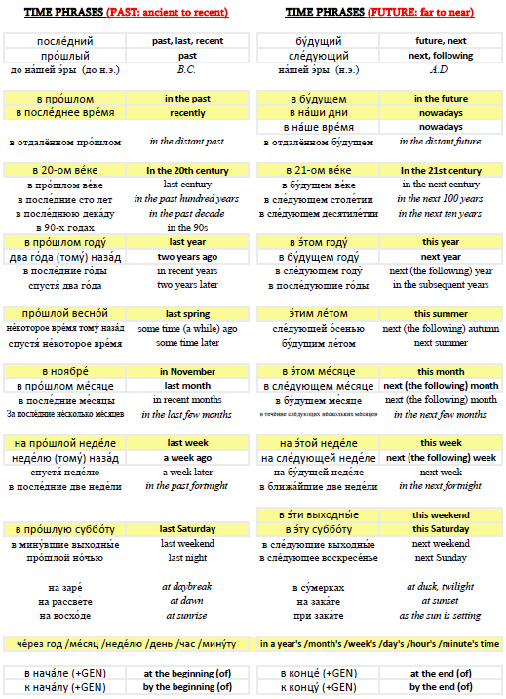
P29: time phrases organised by period
Left = Past
Right = Future
  Centuries
  Years
  Seasons
  Months
  Weeks
  Days
  Parts of days

Slide 18
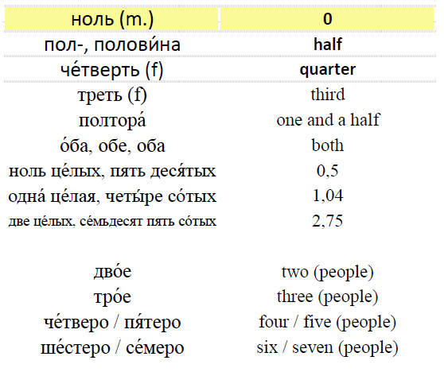
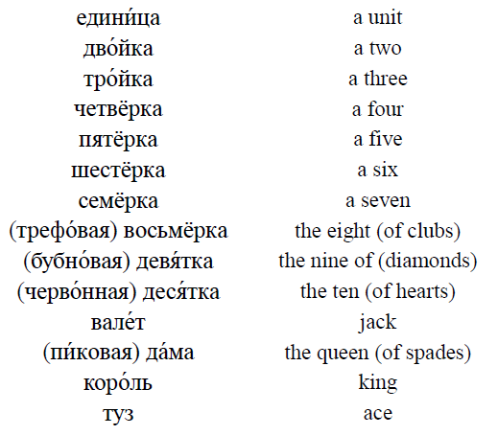
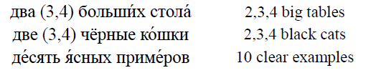
P30: numerals (and related things!)

Slide 19
P35-43: Phrases
Structure
Justifying & Explaining
Opinions
Agreeing & Disagreeing
Balanced Argument
Fillers
Solutions
If you don’t understand…
PROVERBS
IDIOMS

Slide 20
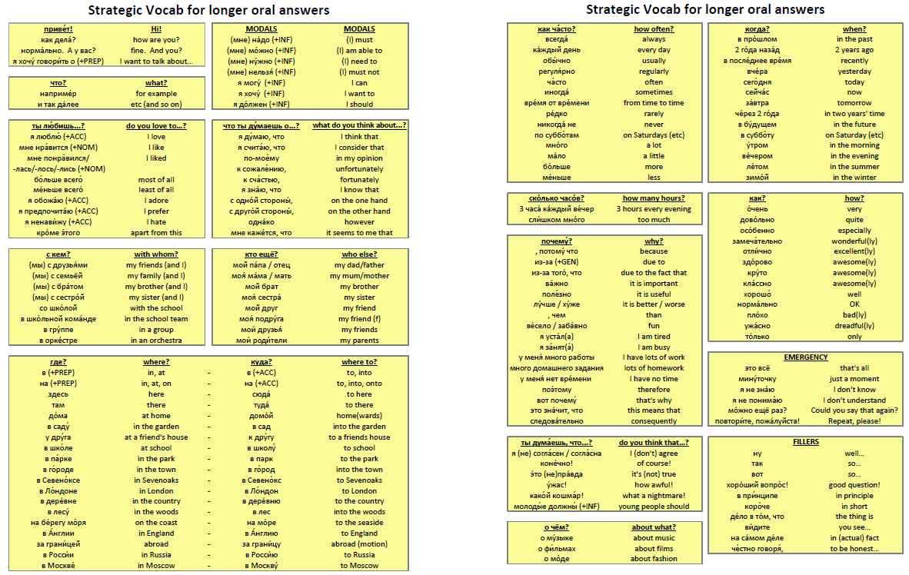
P38-39: GCSE Oral phrases

Slide 21
P46-95: Topic Vocab
PERSONAL - People
- Daily Life
- Free Time
- Food & Drink
LOCAL - School & Work
- In Town
GLOBAL - Travel
- Our World

Slide 22
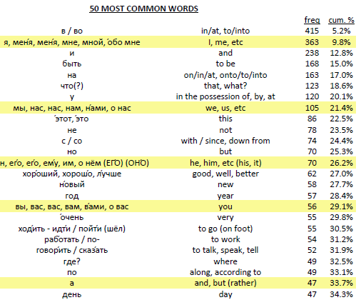
P96-109: GCSE Vocab by frequency
Most frequent words first
Yellow = !!
  только (26)
  даже (10)
  уже (9)
  почти (9)
  выставка (10)
  стена (10)
  сеть (8)
  конкурс (7)
  жизнь (6)
  соревнование (4)

Slide 23
P110-114 Grammar Tables & Lists
NOUNS
PRONOUNS
VERBS
LISTS - verbs that don’t take ACC
- в or на ??
- basic verbs of motion
- other groups of words that act
in a way we might not expect

Slide 24
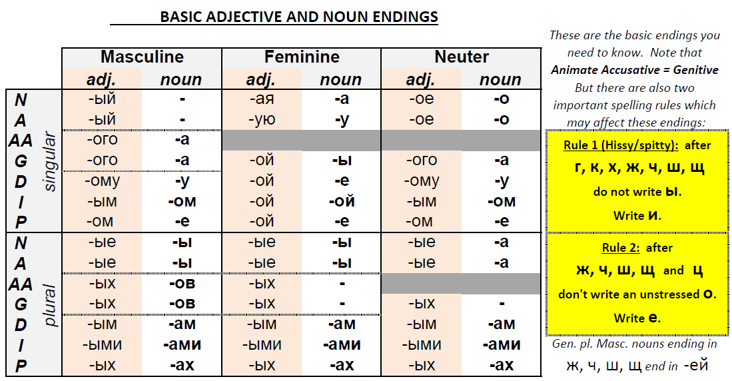
P110: Nouns
Basic noun and adjective endings
Variations are listed below

Slide 25
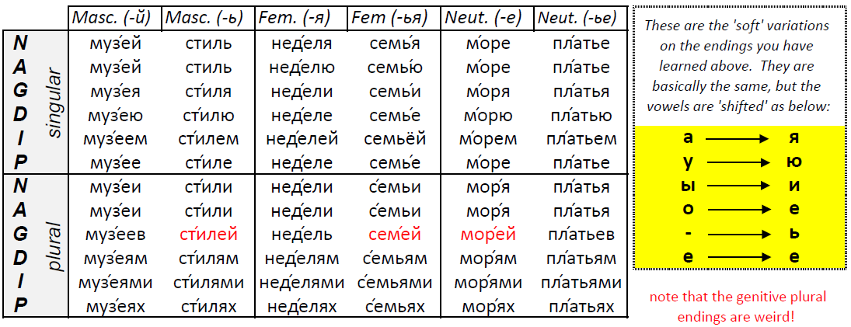
P110: Nouns

Slide 26
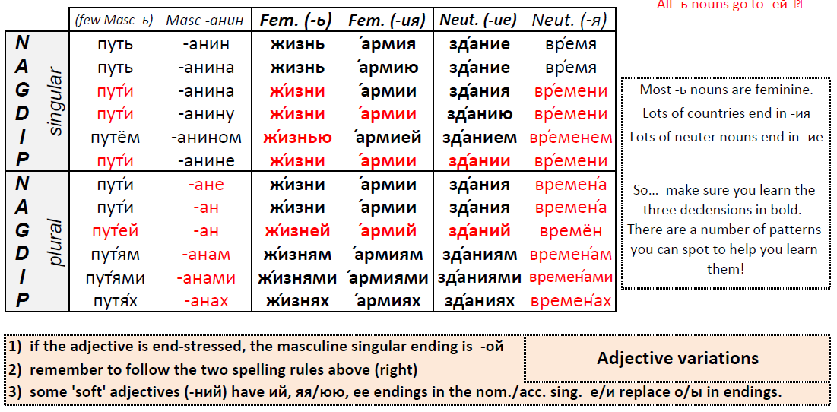
P110: Nouns

Slide 27
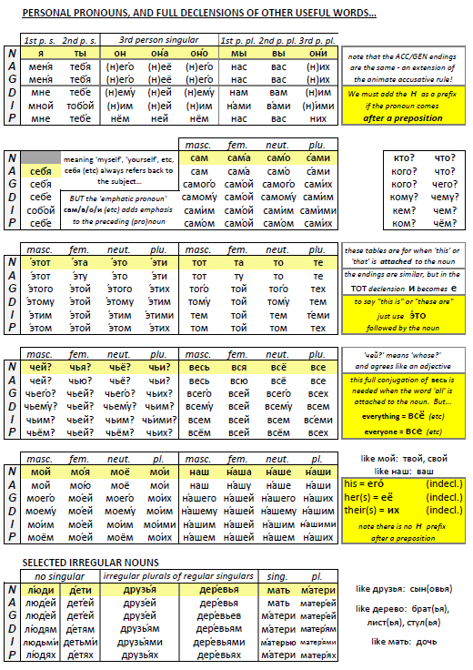
P111: Pronouns

Slide 28
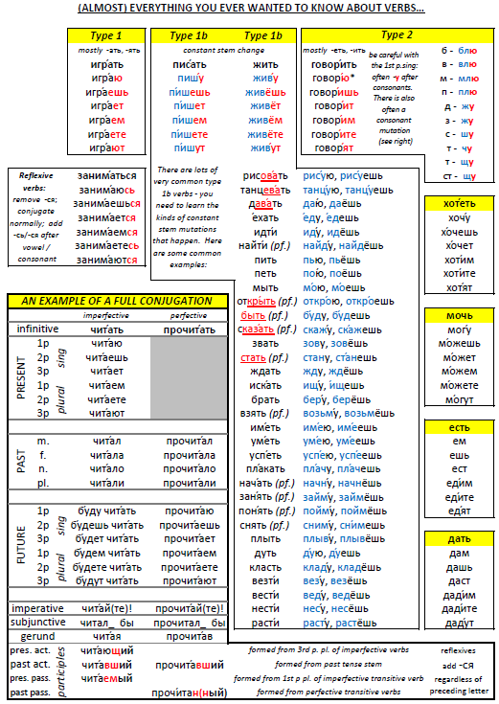
P112: Verbs
Type 1A, 1B, 2
Irregulars
Reflexives
1B conjugations
Also a full conjugation of читать/прочитать, including gerunds, participles and imperatives…

Slide 29
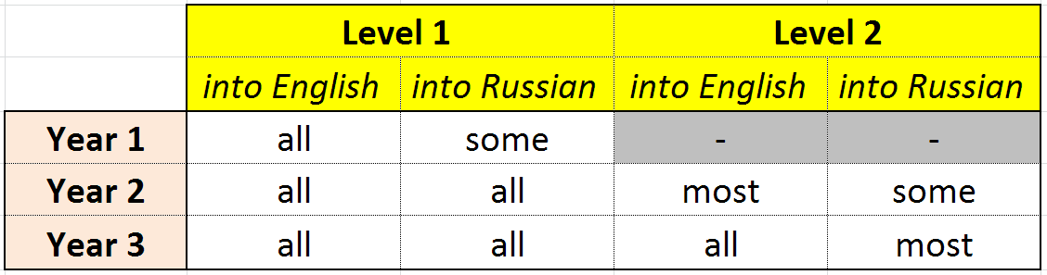
How has QV helped our teaching?
Very clear expectations for pupils in terms of what they need to know
Very useful for differentiation
Very useful for quick reference in class

Slide 30
How can you be a part of QV?
For now, please just let me know:
your name
your email address
where you teach Russian
whom you teach Russian to
Then – please start to use it.

Slide 31
Should I make a donation?
It’s really up to you… see if you like it, see if it’s useful, see if it saves you time…
If you’d like to print your own copies for pupils, consider purchasing a site licence:
  £20 for self-employed tutors (per year)
  £50 per school / university / company (per year)
  Or… however much you are able to…
Or, place an order for ‘wiro-bound’ copies for pupils (ideally by the Easter holidays, so Y11s can have them before GCSE exams)

Slide 32
The Master Spreadsheet… ☺
If you donate some money, or order a batch of books, I will send you the master spreadsheet in Excel.
This will allow you (or your pupils) to very quickly create your own personalised vocab-lists / tests
You can add your own words/phrases
You can create Quizlet sets in minutes…

Slide 33
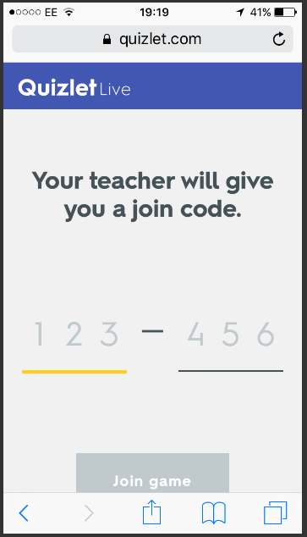
QUIZLET & QUIZLET LIVE
Setting up a Quizlet set, importing the words from the QV Master Spreadsheet
Some examples of Quizlet learning modes
Quizlet Live!
www.quizlet.com/live

Slide 34
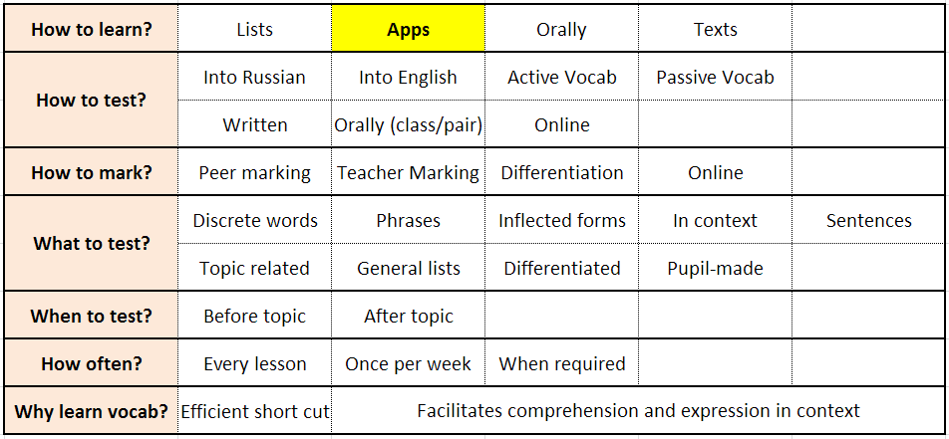
GROUP DISCUSSION…
How do pupils best learn vocabulary?

Slide 35
Contact me…
Jon Drury
russianquadvocab@gmail.com
Search for my sets on Quizlet:
  JDD-Rus (lots of general sets)
  JDD-Rus QV (Quad-vocab)

