Slide 1
Y7 Taster lessons: RUSSIAN
Привет!
(Preevyet!)
Hello!

Slide 2
The Alphabet
There are 33 letters in the Russian alphabet, which is called the ‘cyrillic’ alphabet (after Saint Cyril).
You’ll find you learn them very quickly. Some are just like their English equivalents…
some do not look like any English letters…
and some look like English letters, but are pronounced very differently (hard!)…

Slide 3
Easy letters…
А Т О М К
These letters are just the same as in English…

Slide 4
Some words!
АТОМ
МАМА
КОТ
КАКАО

Slide 5
False Friends…
В - “ v ” in visit
Е - “ ye ” in yet
Н - “ n ” in novel
Р - “ r ” in rebel
С - “ s ” in sit
У - “ oo ” in shoot
Х - “ kh ” e.g. Loch (Scots)

Slide 6
False Friends (practice)
У Х
С Р Е
Н В

Slide 7
Some words!
ТОСТ
ТЕКСТ
ТЕАТР
МЕТРО

Slide 8
New letters, old sounds…
Б - ‘b’ in belly
Г - ‘g’ in gallows
Д - ‘d’ in deckchair
З - ‘z’ in zoo
Л - ‘l’ in legs
П - ‘p’ in pi
Ф - ‘f’ in (butter)fly

Slide 9
New for Old (practice)
Ф Л
Б П
Д Г З

Slide 10
Some words!
ФАКТ
ПОРТ
СПОРТ
ПАРК

Slide 11
Some words!
РЕСТОРАН
ЛАМПА
БАЛЕТ
ДОКТОР

Slide 12
Some words!
СТУДЕНТ
ФУТБОЛ
ФРУКТ
ЁЖ !

Slide 13
New vowels!
Ё - ‘yo’ in yonder
И - ‘ee’ in feed
Й - ‘y’ in boy
Ы - ‘i’ in ill (or œuil in French)
Э - ‘e’ in bed
Ю - ‘yu’ in yuletide
Я - ‘ya’ in yak

Slide 14
New vowels (practice)
Ю И Я
Й Ы
Э Ё

Slide 15
The final 7 (hard)!
Ж - ‘zh’… like ‘s’ in pleasure
Ц - ‘ts’ in hits
Ч - ‘ch’ in check
Ш - ‘sh’ in shot
Щ - ‘sh-sh’ in fish shop
Ъ - “HARD SIGN”…
Ь - “SOFT SIGN”…

Slide 16
The final 7 (practice)!
Щ Ж Ъ
Ч Ш
Ц Ь

Slide 17
More words…
ТУРИСТ
МУЗЕЙ
МУЗЫКА
ВОЛЕЙБОЛ

Slide 18
More words…
ШОК
ЮМОР
БРАТ

Slide 19
More words…
ПРИВЕТ
КАК ДЕЛА?
ХОРОШО
ПЛОХО

Slide 20
Alphabet (1st half)…
А Б В Г Д Е
Ё Ж З И Й К Л М Н О П Р

Slide 21
Alphabet (2nd half)…
С Т У Ф Х Ц Ч Ш Щ Ъ Ы Ь Э Ю Я

Slide 22
Привет!
Как дела?
хорошо
плохо
очень
пока!
спасибо
(большое)
нормально
ничего
да
нет
не
как тебя зовут?
меня зовут ____
пожалуйста

Slide 23
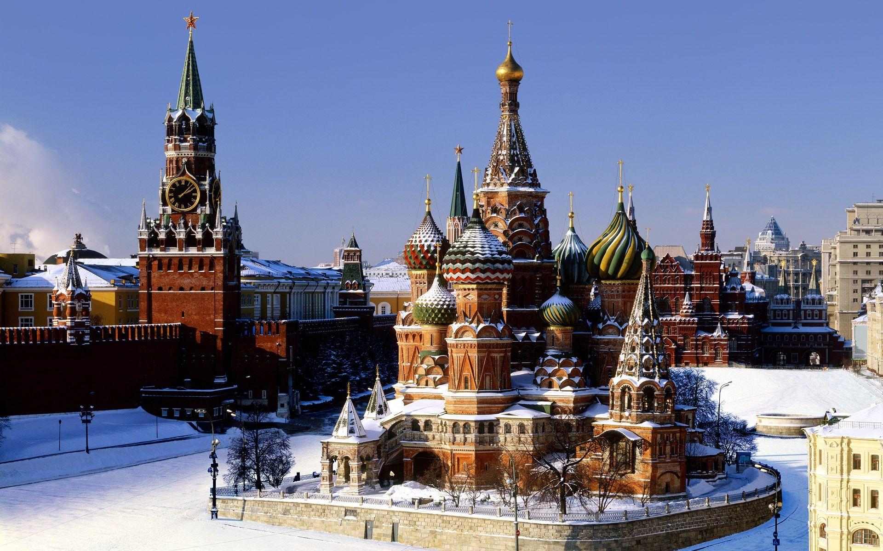
Русский (Russian)
RED SQUARE, MOSCOW

Slide 24
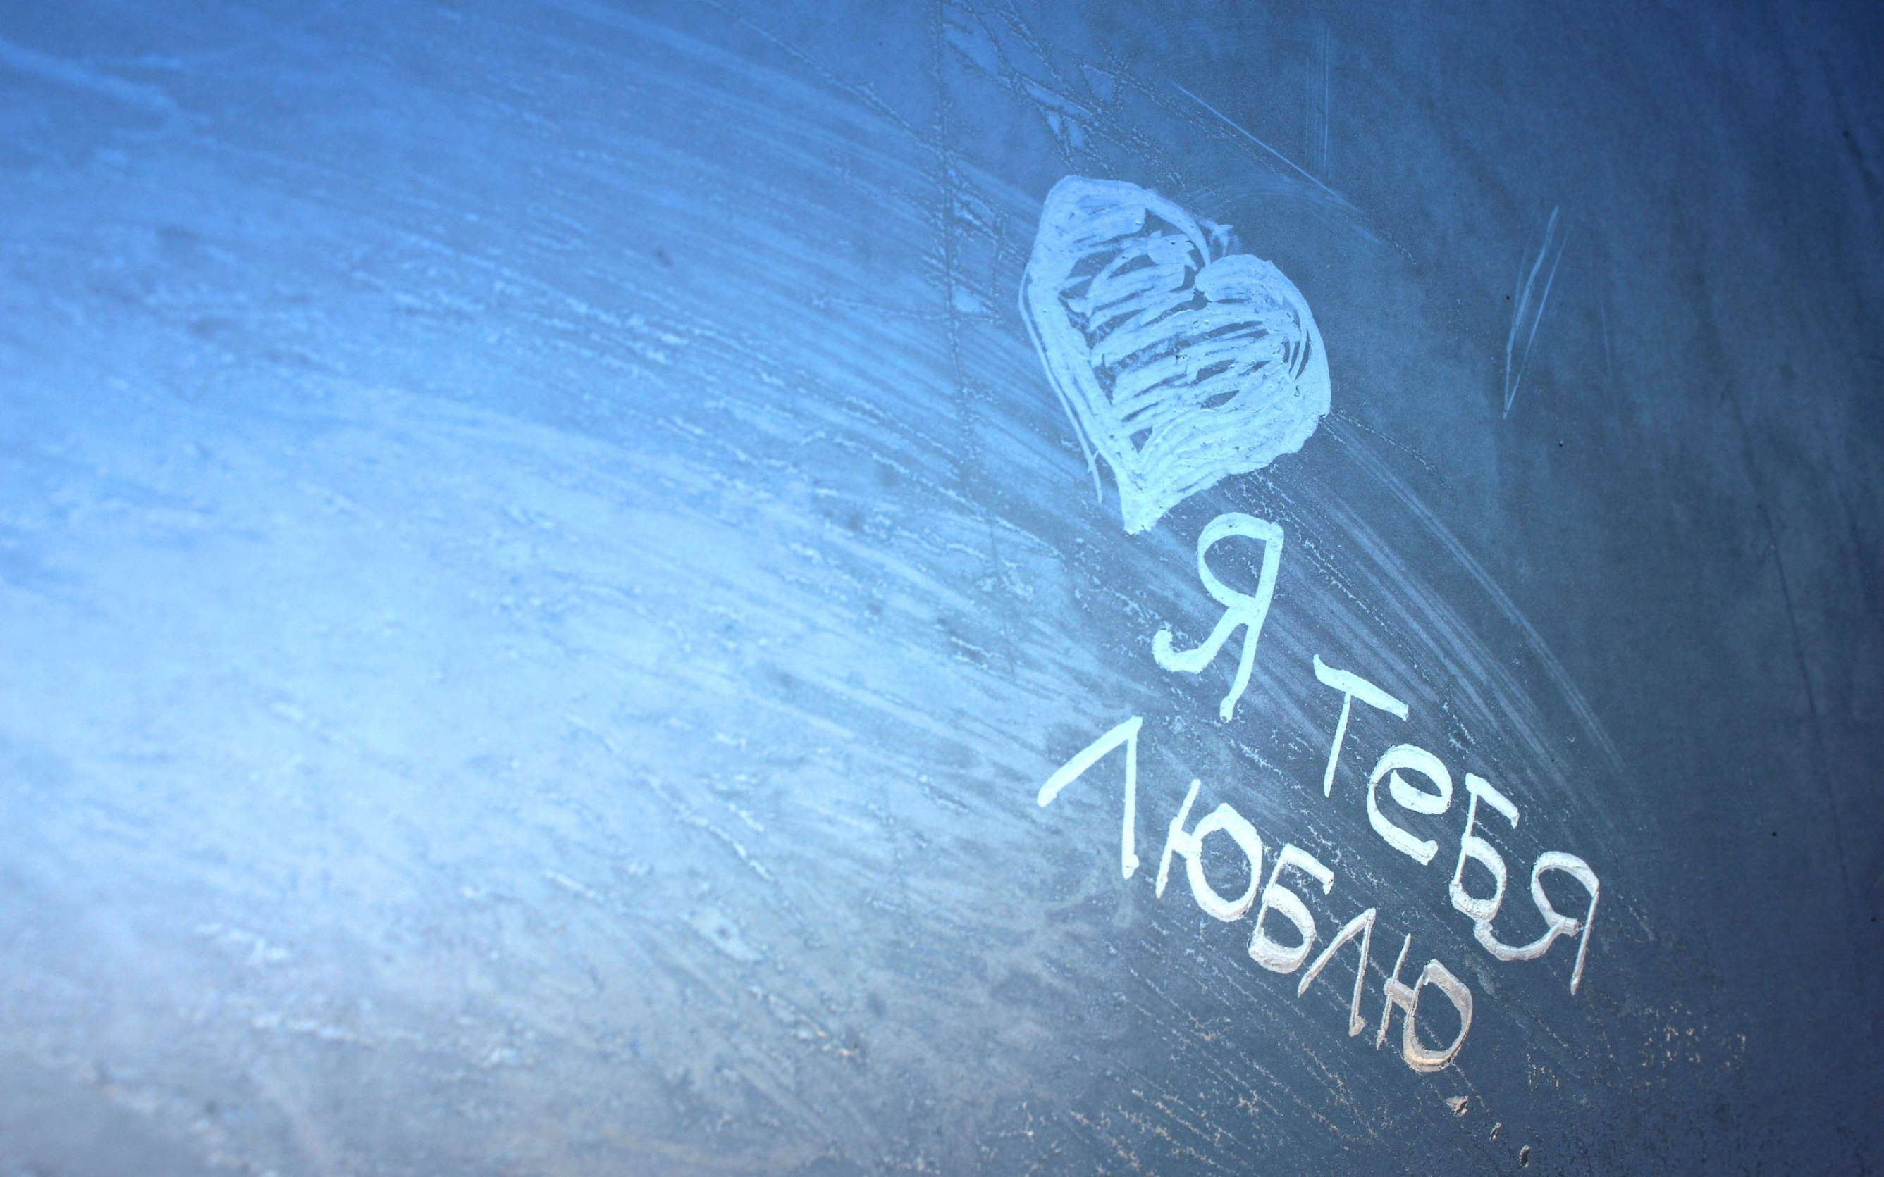
“I love you”
WHY CHOOSE RUSSIAN?
There’s just something about Russian.
It gets under your skin.
It gets in your head.
People who study Russian love it.
90% of those who start Russian at Sevenoaks continue to GCSE.

Slide 25
Amazing History.
Amazing Literature.
Amazing Culture.
Amazing People.
An incredible adventure ahead?
But most of all, an amazing language…

Slide 26
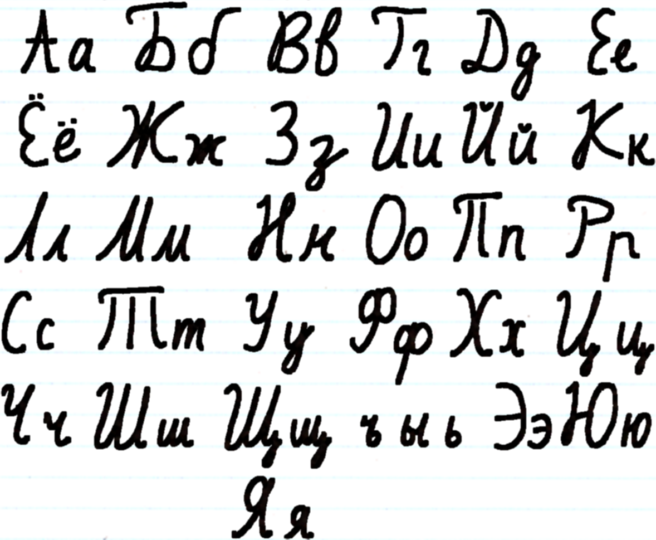
Russian is written in ‘cyrillic’.
It looks cool.

Slide 27
Longest word I know
ДОСТОПРИМЕЧАТЕЛЬНОСТИ
Dasta – preemye –
chatel – nastee
(sights)

Slide 28
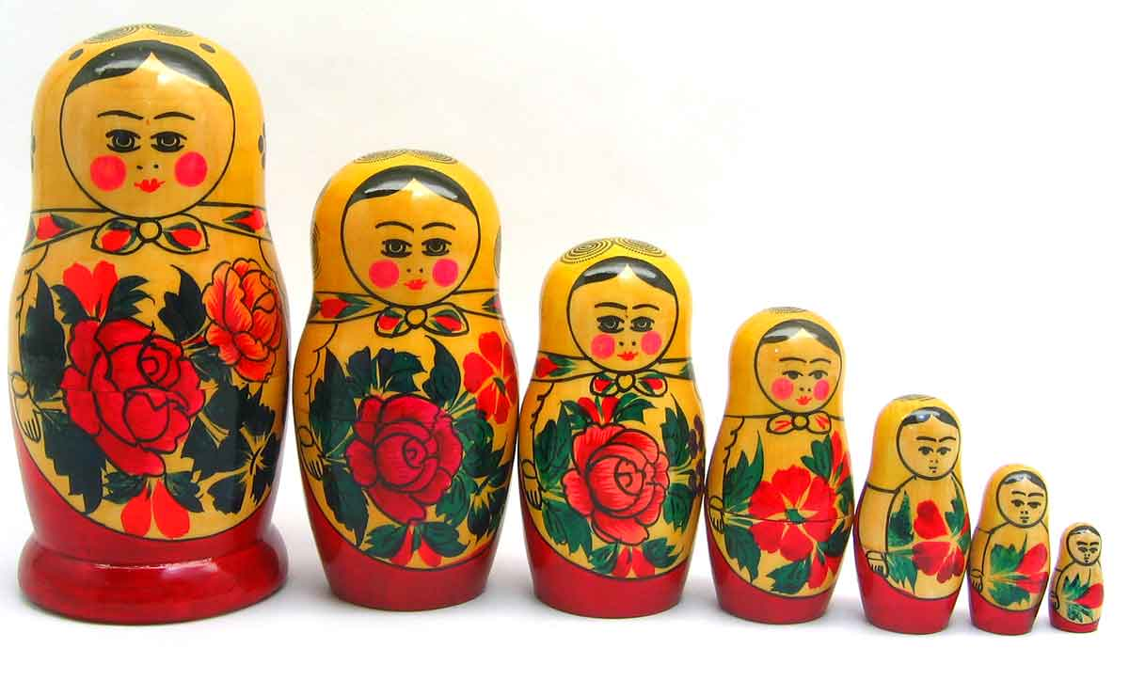
WHY CHOOSE RUSSIAN?
Sevenoaks has one of the largest and best Russian Departments in the country – over 100 pupils study it from Y8 to U6.
About 16 Y8 pupils start Russian each year.
(talk to them!)

Slide 29
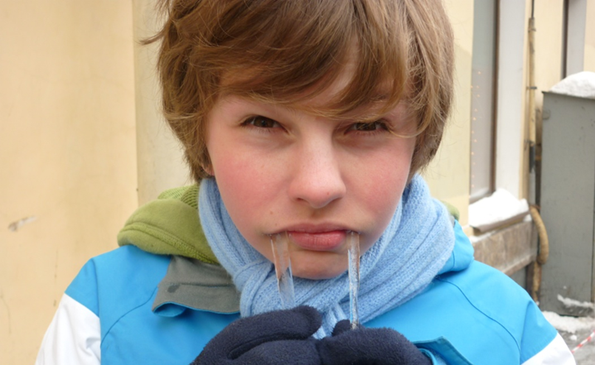
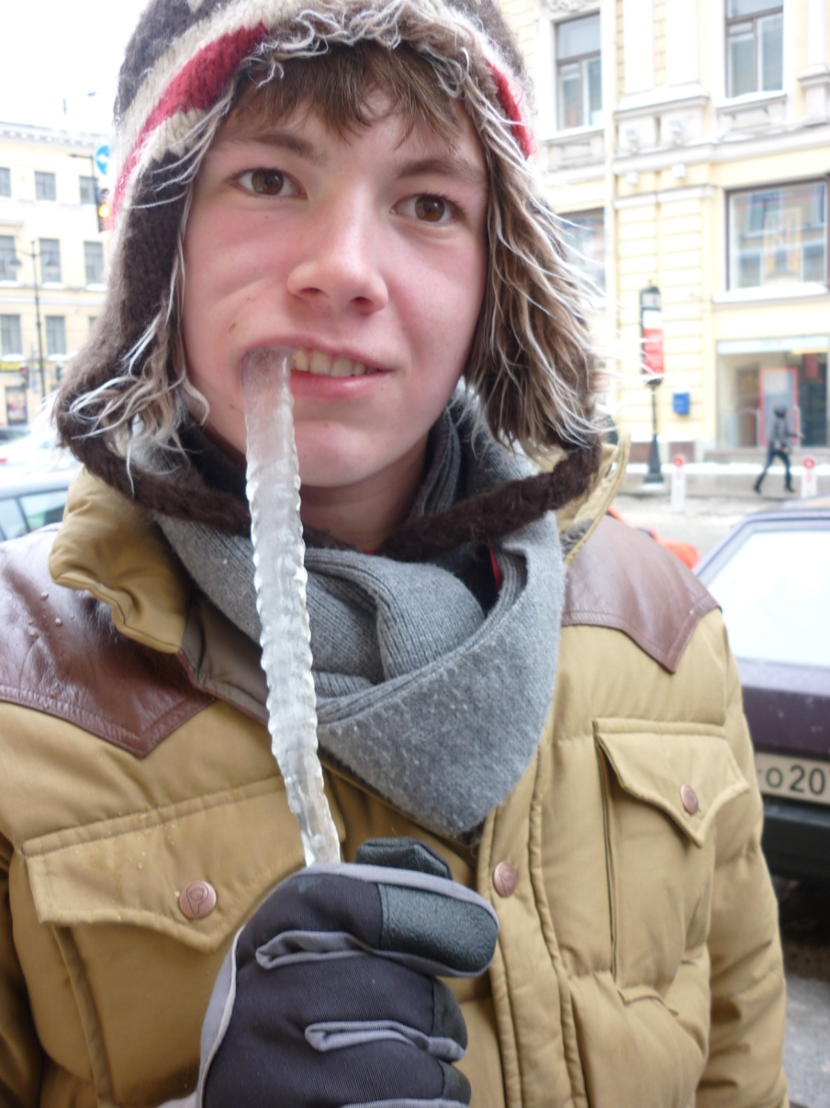
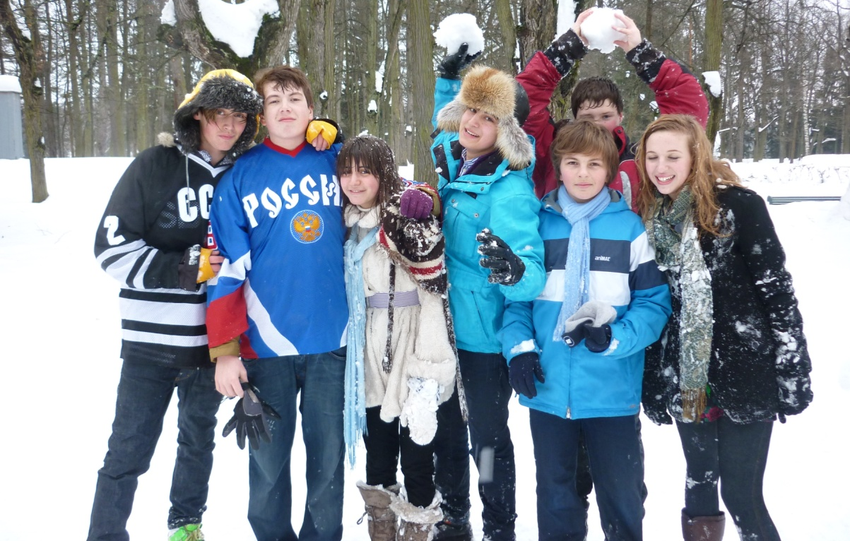
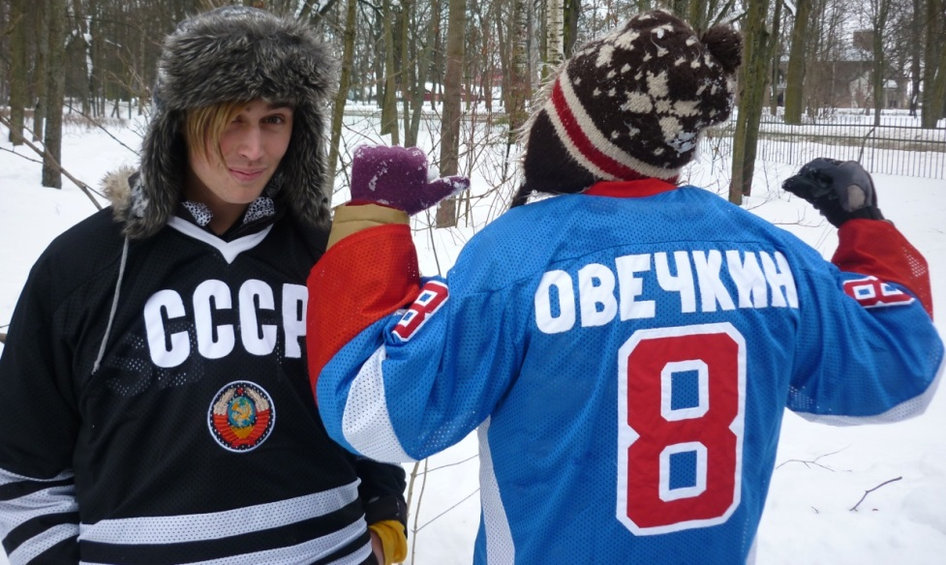
Come to Russia with us…

Slide 30
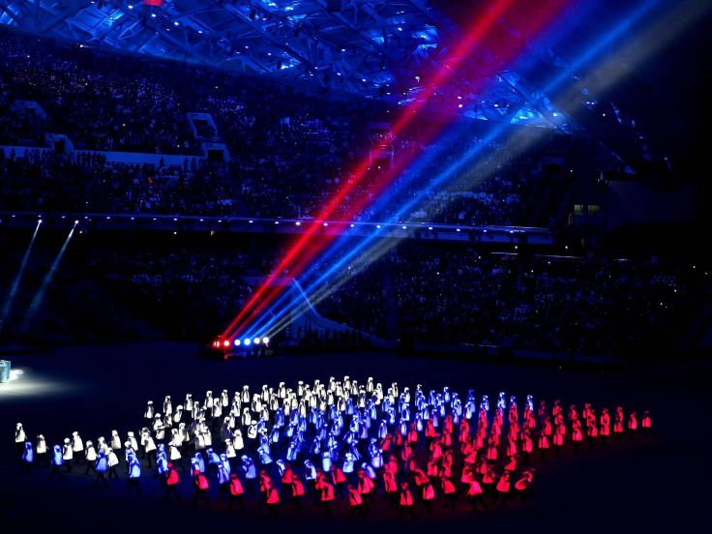
Very few people know Russian.
Do you want to be different?
To start the adventure?
To take the road less travelled?
Yes?
Study Russian.n.

Slide 31
Thank you!
Спасибо!
(spaseeba)

Slide 32
Goodbye!
До свидания!
(da sveedanya)

Slide 33
Why choose Russian?
It’s FUN!
Learning the Cyrillic alphabet is actually very easy, yet very impressive to everyone else!
Fascinating culture and crazy people!
Opportunity to visit Russia in Y10!
Not many people learn Russian in this country – Sevenoaks has one of the largest Russian departments in the UK. Take the opportunity to be special!

