Slide 1
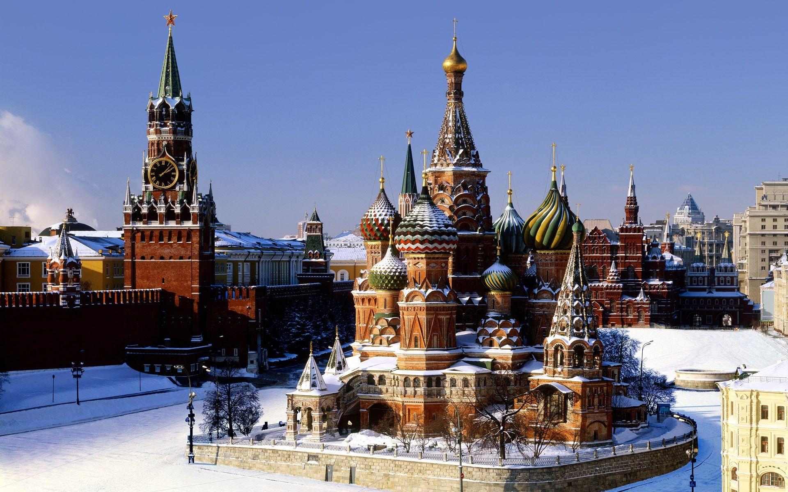
Русский (Russian)
RED SQUARE, MOSCOW

Slide 2
Y7 post-offer Taster lesson
Привет!
(Preevyet!)
Hello!

Slide 3
The Alphabet
There are 33 letters in the Russian alphabet, called ‘cyrillic’ (after St Cyril).
some are similar to English
some look like English letters, but are pronounced very differently (hard!)…
- some look a bit crazy…

Slide 4
Easy letters…
К О М Е Т А
These letters are just the same as in English…

Slide 5
Some words!
МАМА
АТОМ
КОТ
КОМЕТА

Slide 6
Tricky letters…
С - “ s ” in sit
Р - “ r ” in rebel
Н - “ n ” in novel
И - ‘ee’ in feed
Я - ‘ya’ in yak

Slide 7
Tricky letters (practice)
И Р
С
Н Я

Slide 8
Some words!
ТОСТ
ТЕКСТ
ТЕАТР
МЕТРО

Slide 9
Some words!
ТЕННИС
ТАКСИ
АРТИСТ
ИНТЕРНЕТ

Slide 10
Some words!
РЕСТОРАН
СЕКРЕТ
СЕСТРА
СТРЕСС

Slide 11
New letters, old sounds…
Б - ‘b’ in belly
Г - ‘g’ in gallows
Д - ‘d’ in deckchair
Л - ‘l’ in legs
П - ‘p’ in pi
Ф - ‘f’ in (butter)fly

Slide 12
New for Old (practice)
Ф Л
Б П
Д Г

Slide 13
Some words!
БАЛЕТ
БРАТ
ГИТАРА
АДРЕС

Slide 14
Some words!
ПОРТ
СПОРТ
ОПЕРА
ПАКЕТ

Slide 15
Some words!
ЛАМПА
ФАКТ
КОФЕ
ОФИС

Slide 16
Some words!
МИКРОФОН
ТРАНСПОРТ
КОРИДОР
ПРОБЛЕМА

Slide 17
Everything!!!
К О М Е Т А
С Р Н И Я
Б Г Д Л П Ф

Slide 18
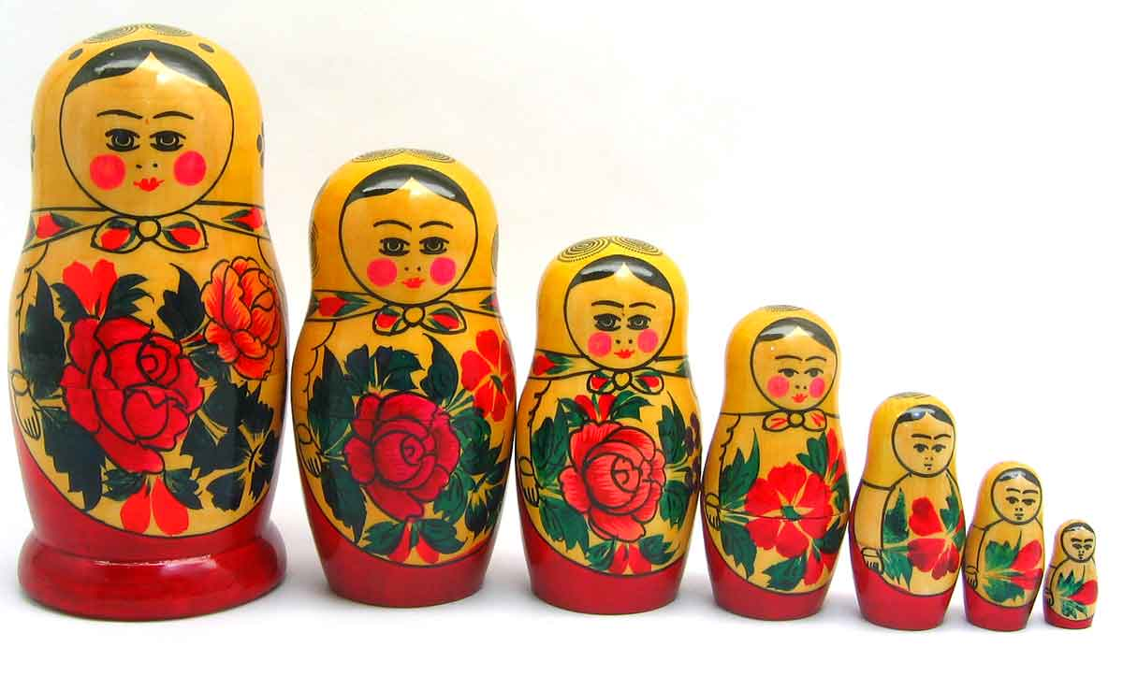
WHY CHOOSE RUSSIAN?
Sevenoaks has one of the largest and best Russian Departments in the country – over 110 pupils study it from Y8 to U6.
About 16 Y8 pupils start Russian each year.
(talk to them!)

Slide 19
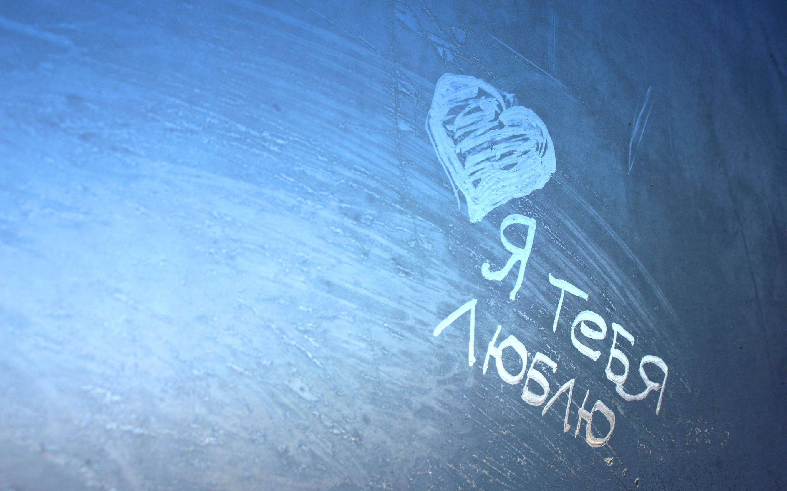
“I love you”
WHY CHOOSE RUSSIAN?
There’s just something about Russian.
It gets under your skin.
It gets in your head.
People who study Russian love it.
90% of those who start Russian at Sevenoaks continue to GCSE.

Slide 20
Amazing History.
Amazing Literature.
Amazing Culture.
Amazing People.
An incredible adventure ahead?
But most of all, an amazing language…

Slide 21
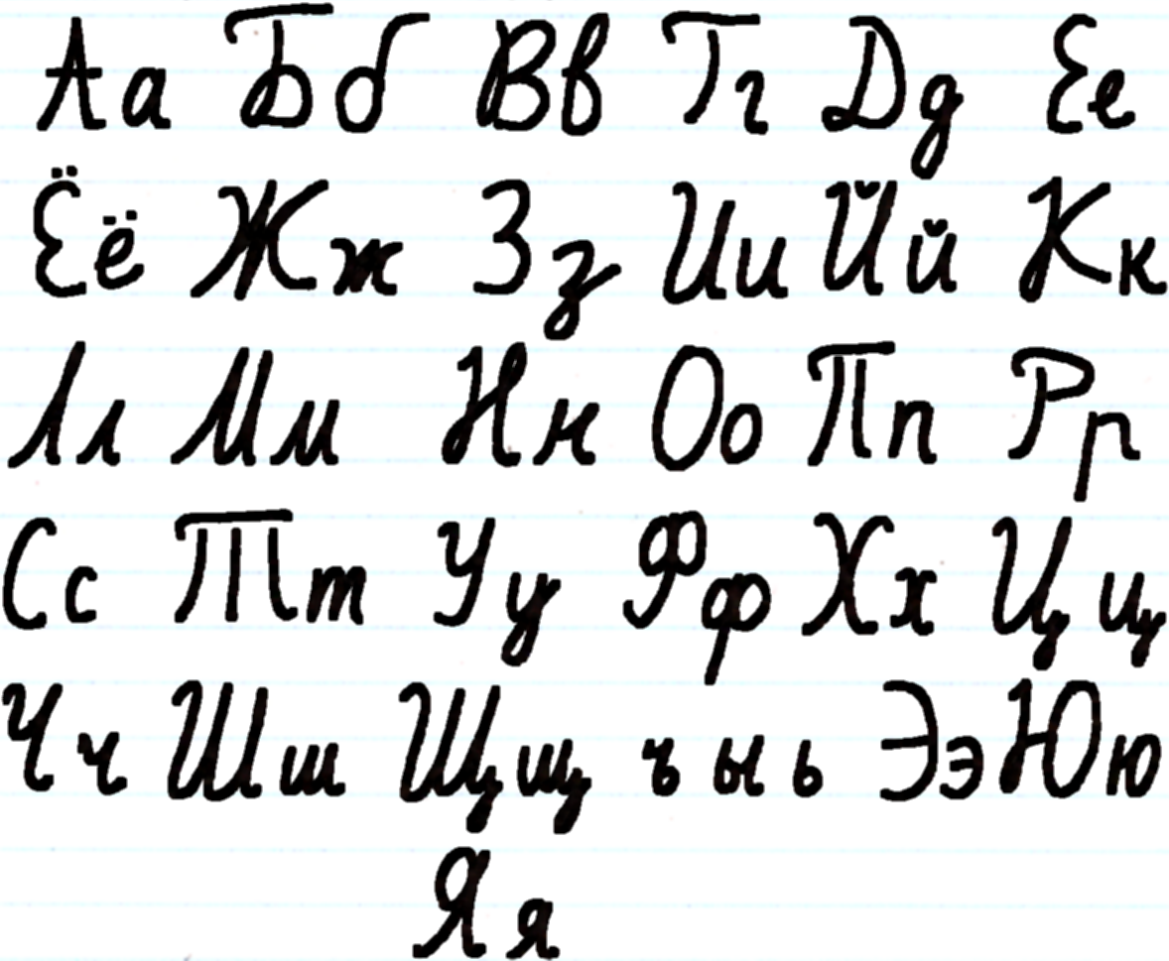
Russian is written in ‘cyrillic’.
It looks cool.

Slide 22
Longest word I know
ДОСТОПРИМЕЧАТЕЛЬНОСТИ
Dasta – preemye –
chatel – nastee
(sights)

Slide 23
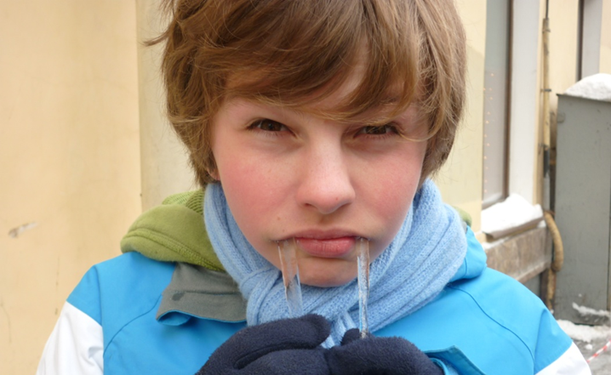
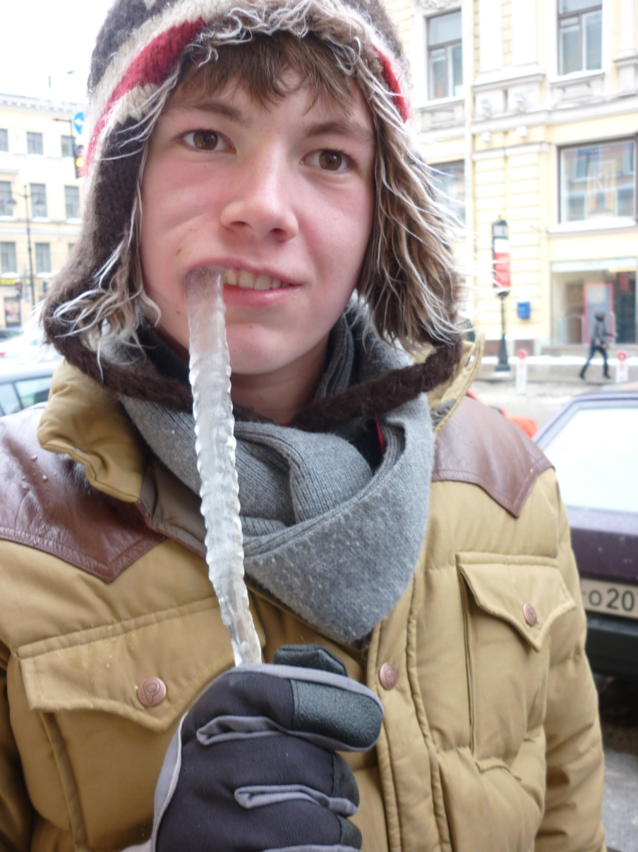
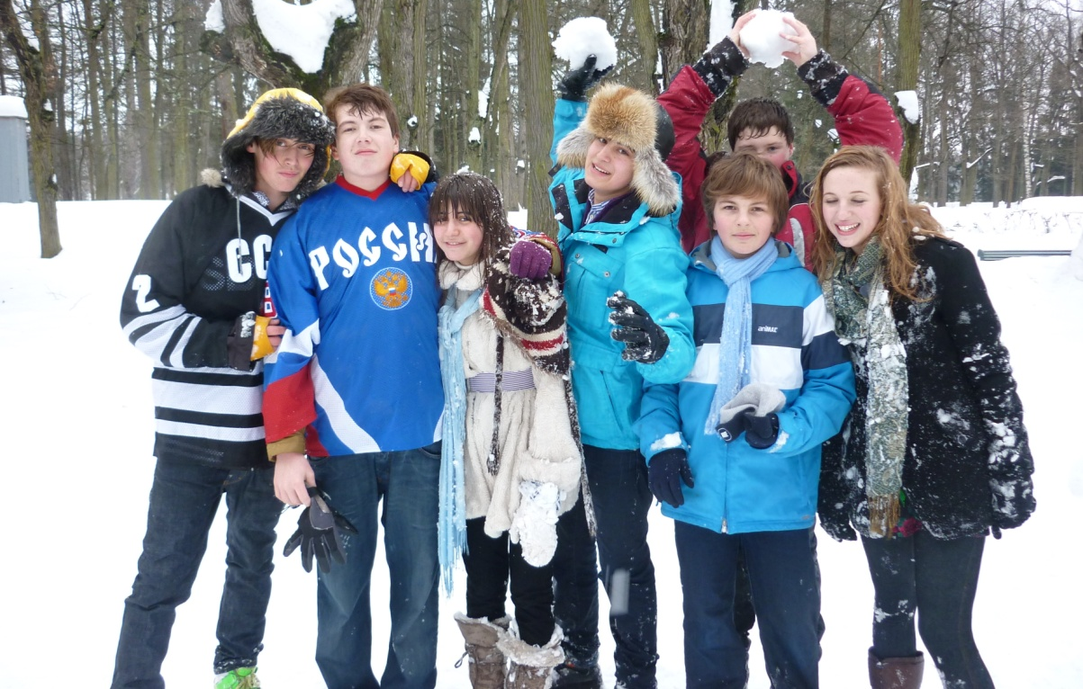
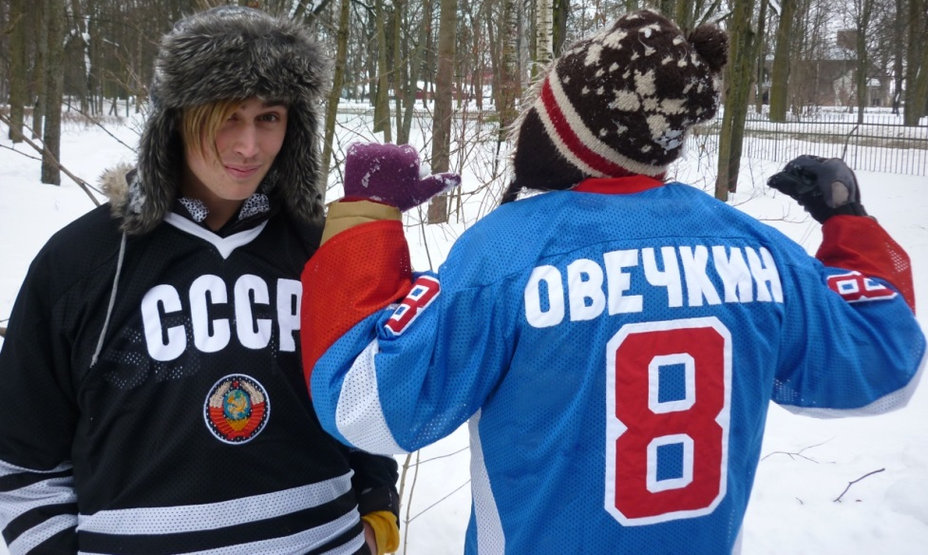
Come to Russia with us…

Slide 24
Why choose Russian?
It’s FUN!
Learning the Cyrillic alphabet is actually very easy, yet very impressive to everyone else!
Fascinating culture and crazy people!
Opportunity to visit Russia in Y10!
Not many people learn Russian in this country – Sevenoaks has one of the largest Russian departments in the UK. Take the opportunity to be special!

Slide 25
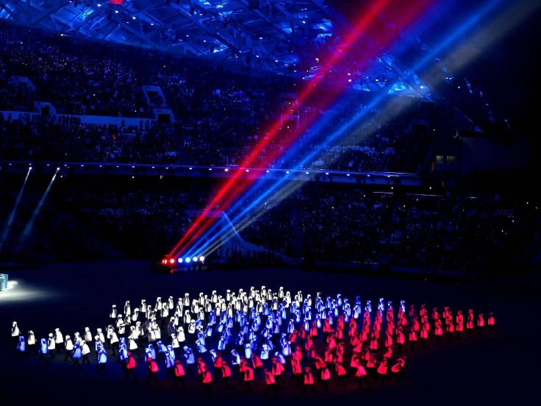
Very few people know Russian.
Do you want to be different?
To start the adventure?
To take the road less travelled?
Yes?
Study Russian.n.

Slide 26
Thank you!
Спасибо!
(spaseeba)

Slide 27
Goodbye!
До свидания!
(da sveedanya)

